Slide 1
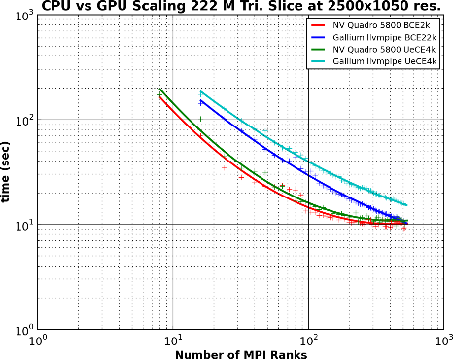
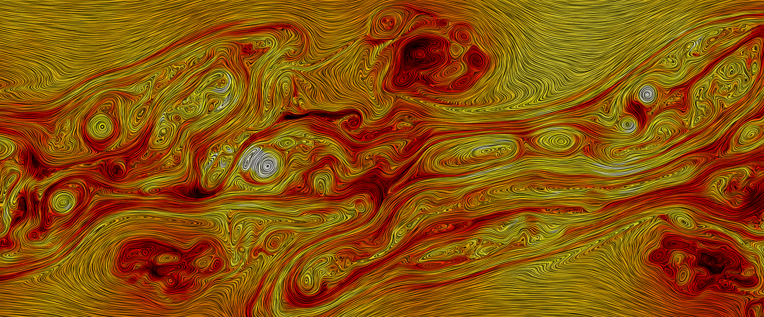
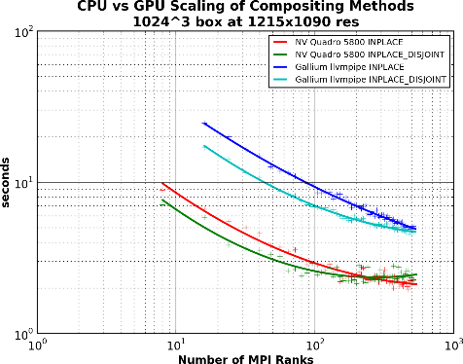

Visualization and analysis of coherent structures, intermittent turbulence, and dissipation in high-temperature plasmas
Application:
Results:
Interactive remote parallel visualization and analysis of large vector fields
8TB VPIC magnetized plasma sim. 4x10¹⁰ part. 72hrs 50k cores Jaguar.
New scalable visualization algorithm deployed in ParaView enabled interactive analysis of 8TB PIC simulation on NERSC Edison Ph. 1
New insight into dissipation mechanisms at kinetic scales. (Journal Pubs: POP, PRL. Talks: APS, GEM, AGU, XSEDE, SC)
Improvements to VTK rendering infrastructure (in addition to new algorithms)
Support “zero copy” communication of MPI+GPGPU
Support advanced rendering algorithms without GPUs using Mesa3D gallium llvmpipe / “offscreen” renderers.
Working w/ SDSC and Kitware to apply in-situ analysis of KH driven vortices at the magnetopause using Catalyst in global magnetospheric simulation.
Goal/Requirement:
Parallelize vector field visualization techniques so that very large datasets may be explored/visualized interactively remotely
Scalable rendering via MPI hybrid parallelism. MPI+GPGPU, MPI+pthreads. (NERSC8: Are GPUs worth the $$?)
Work with existing infrastructure libraries VTK + IceT to ensure that the new algorithms are accessible in ParaView and VisIt.
Science: Understand dissipation mechanisms in turbulent plasmas. Eg. heating in the solar wind.
Figure goes here
Left: Parallel Rendering MPI+GPU vs. MPI+pthreads Scaling Results. Above: Visualization of coherent structures in a turbulent plasma using new data-parallel surface LIC algorithm made on Edison with 256 cores.
Notes:
In this work we developed a scalable data-parallel surface LIC algorithm for remote interactive rendering working within the constraints of existing vis infrastructure (VTK + IceT) driven by the need to analyze very large simulation data interactively. We deployed the work in ParaView and used it to investigate dissipation mechanism in turbulent plasmas at kinetic scales.
Because many supercomputers do not have GPUs we had to add support to VTK for advanced rendering algorithms without GPUs. This presented the opportunity to compare hybrid parallel rendering with and without GPUs. Without GPUs we use pthreads to leverage multicore capabilities of HPC systems such as Edison. This work is of interest for NERSC’s future procurement, because an active topic of debate when spec’ing the vis partition has been “Are GPUs worth the expense?”
A concise summary of the simulation run, visualization, analysis, and science results may be found here in my SC13 Vis showcase submission. http://www.hpcvis.com/vis/images/sc13/sc13-vsc-report.pdf
1

